Slide 1
Netflix Data Anaysis Workbook
File created on: 20/04/2023 20:16:00

Slide 2
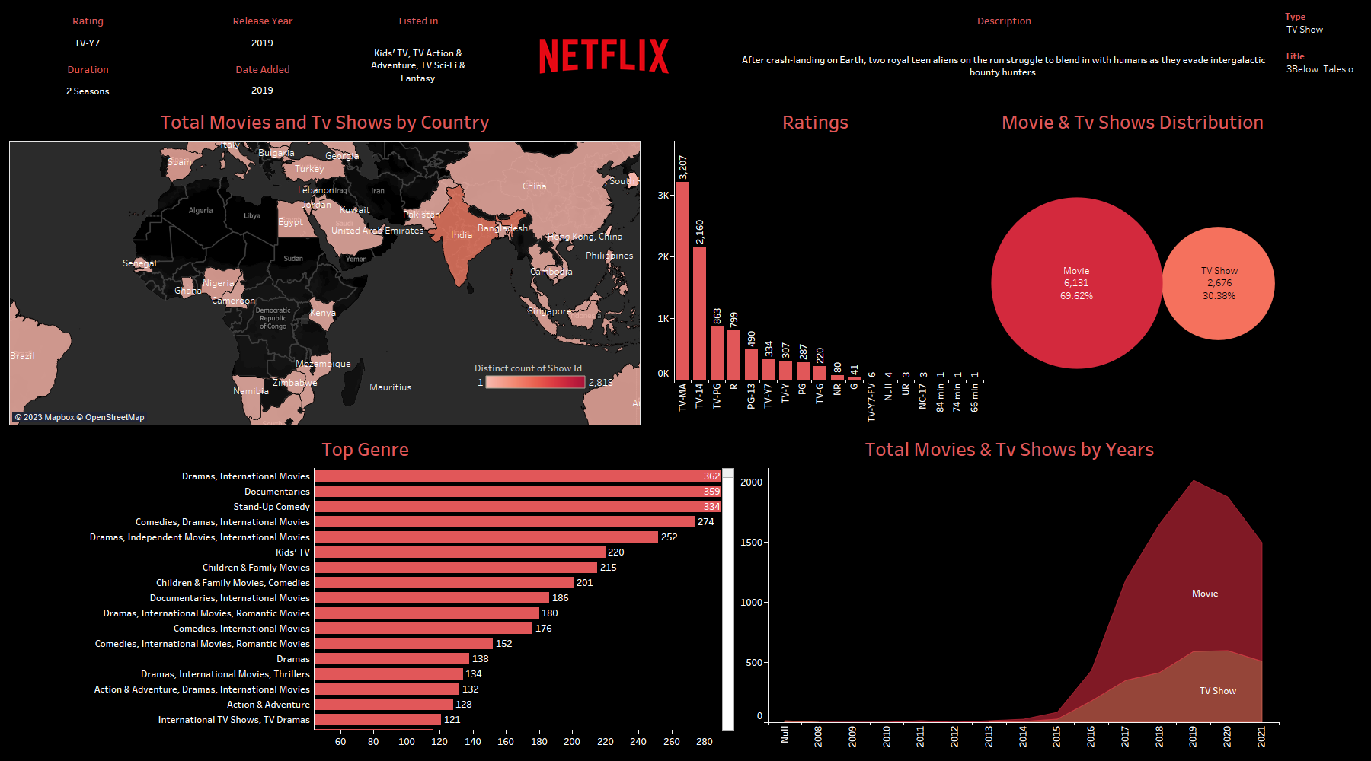

Slide 3
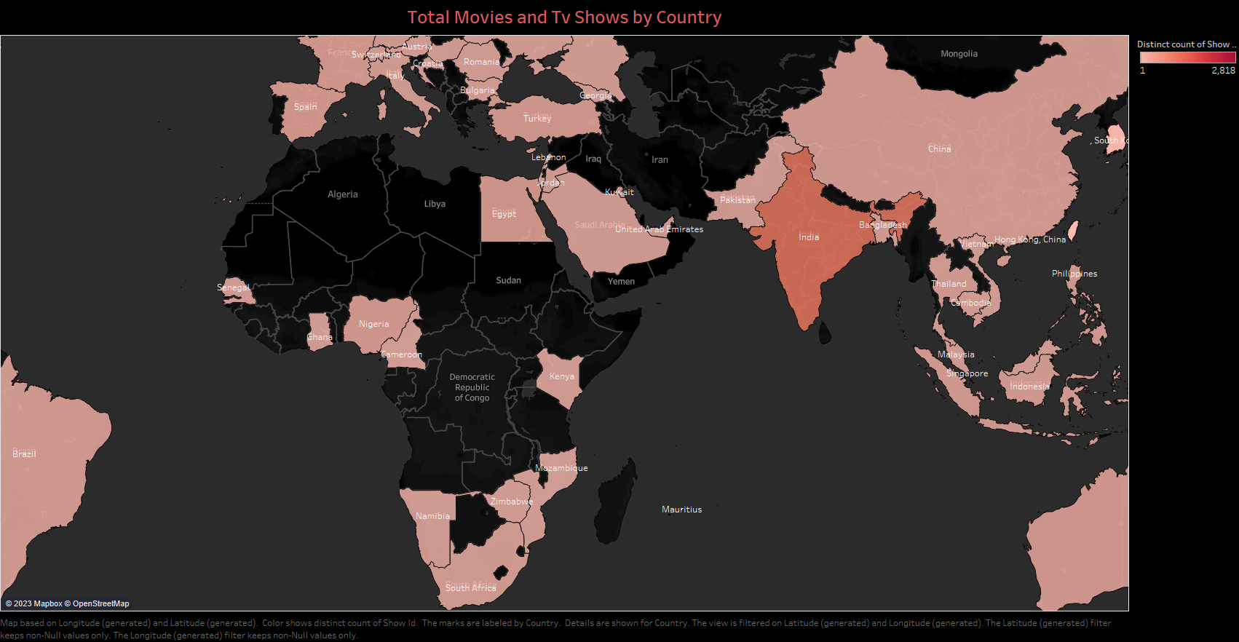

Slide 4
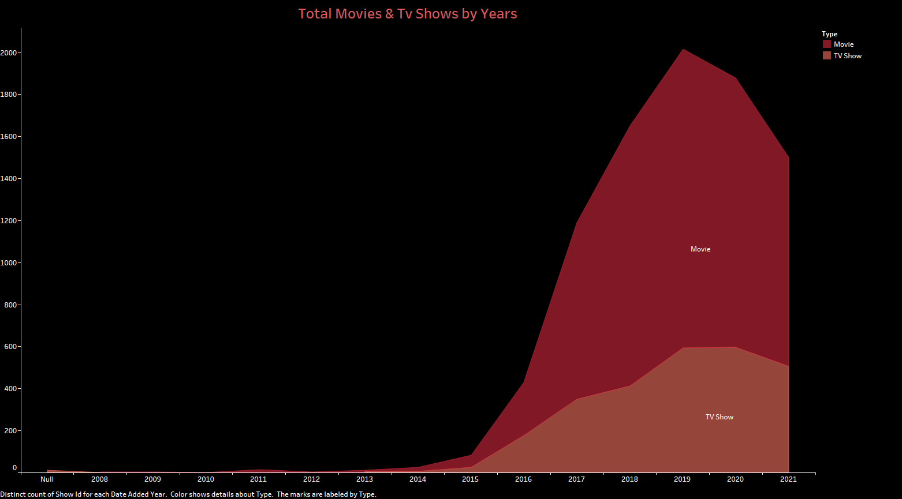

Slide 5
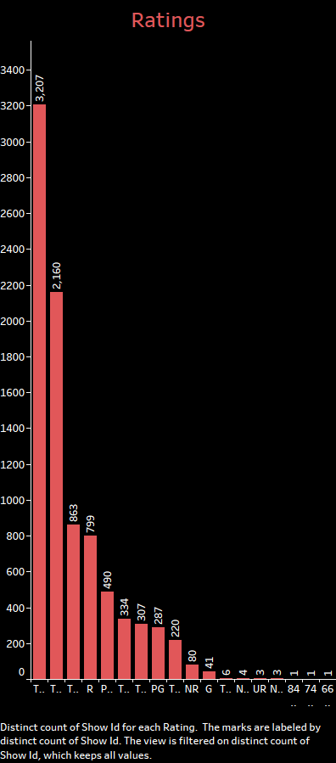

Slide 6
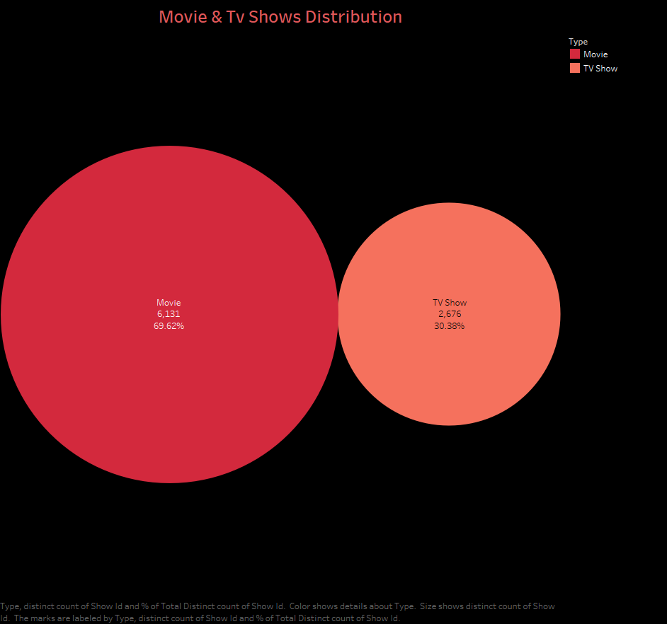

Slide 7


